Slide 1
Helping Your Community with Indoor Air Quality and mold resources from DOH
Ali Boris, Indoor Air Quality Specialist
May 2024 ● WSEHA AEC

Slide 2

Goals for today
Go over DOH resources, common concerns
  Follow IAQ Basics
  Updates
  Newly created resources
  Best practice notes
Listen and learn from you
  What is needed? Ideas? Feel free to yell it out!

Slide 3
We spend most of our days in indoor environments, which means the air we breathe in our homes and workspaces has a big impact on our health.

Slide 4
Indoor Air Quality Management Basics
Remove the Source
Ventilate Well
Keep it Dry
Keep Outdoor Pollution Out
Source: Indoor air a neglected source of chemical, particulate exposures - NIH Environmental Factor, May 2021

Slide 5
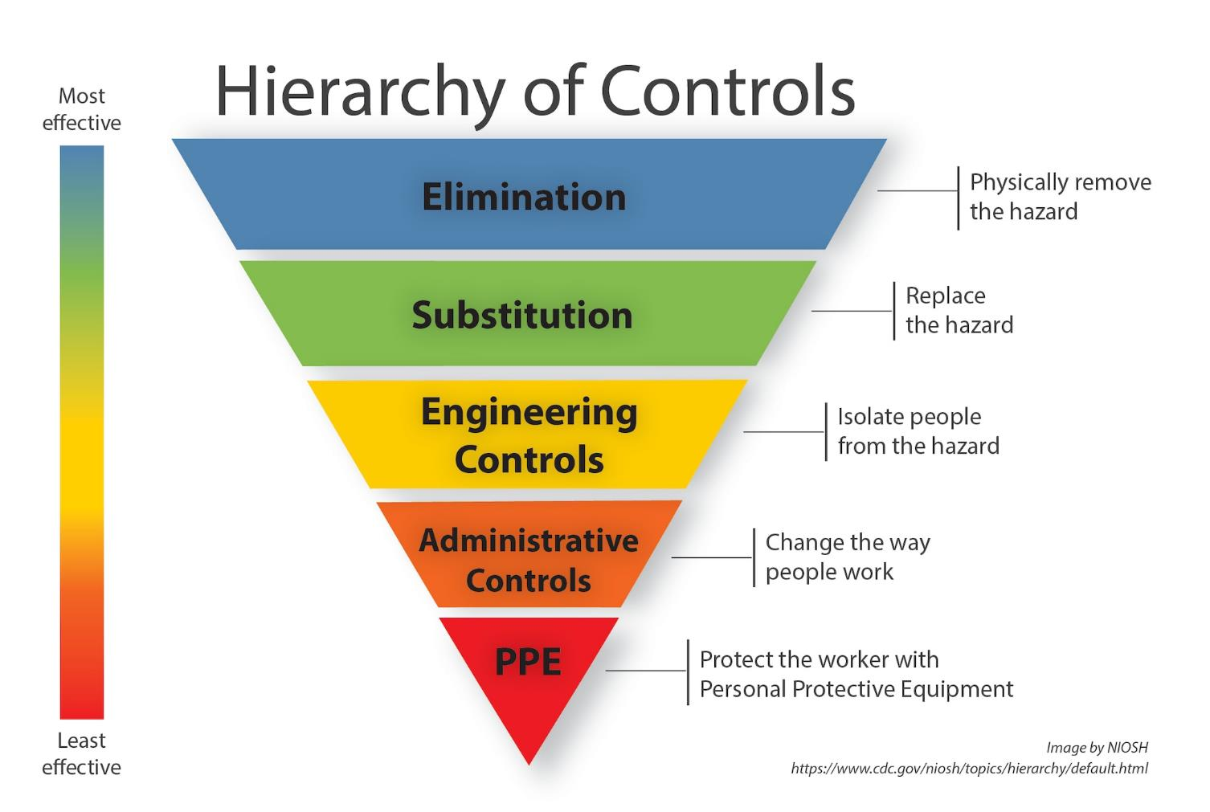

Slide 6
The Washington DOH School Environmental Health & Safety and Indoor Air Quality Program has resources for residents, schools, and local health partners.

Slide 7

Indoor Air Quality Questions
Do you get these questions from the public?
  How do I get my home tested for mold?
  How do you clean up mold?
  Will you come test my house? I keep getting sick.
We have information and resources to help.

Slide 8
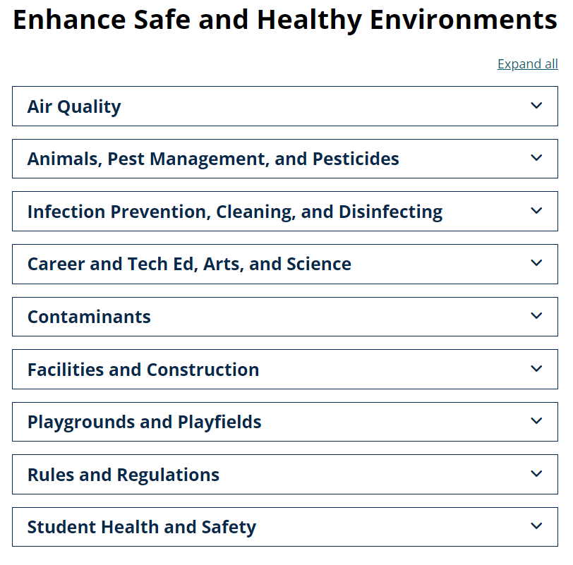
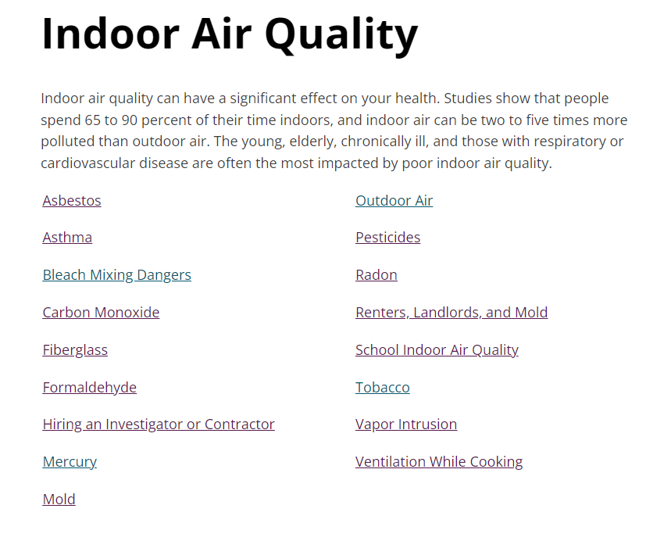
Our Websites
Schools:
www.doh.wa.gov/schoolenvironment
www.doh.wa.gov/iaq
Webpages on each of these topics

Slide 9
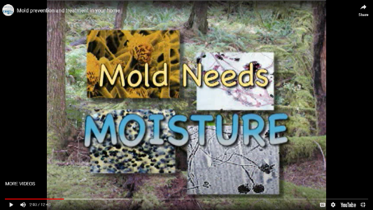
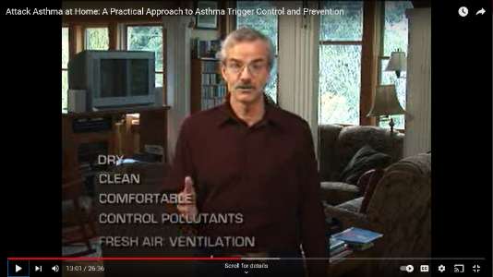
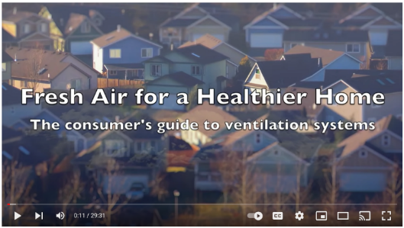
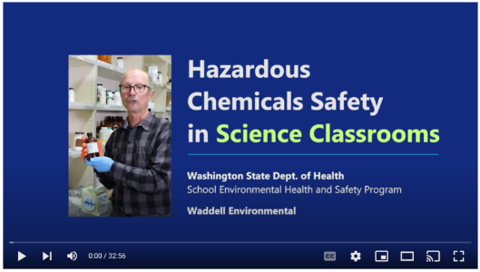
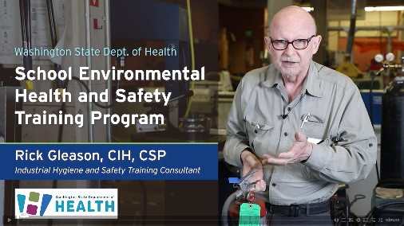
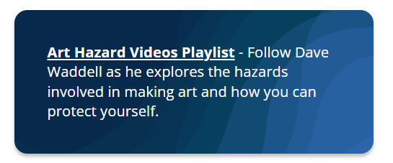
Videos!
Homes/General
  Mold Prevention
  Asthma Trigger Control
  Healthy Home Air
    Ventilation, HRV/ERV systems
Schools
  IAQ School Walkthroughs
  Hazardous Chemical/Safety in:
    Auto, Metal, Wood Shops
    Art Classrooms
    Science Classrooms
  Art Hazards
NEW
NEW

Slide 10
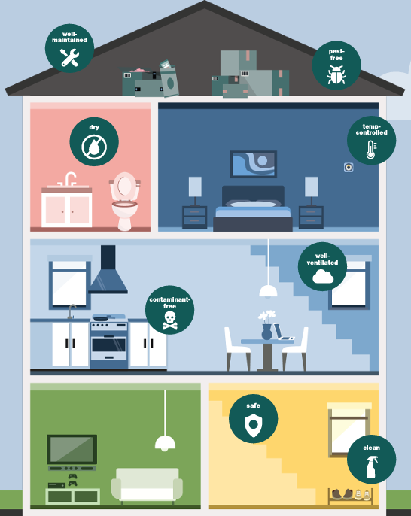
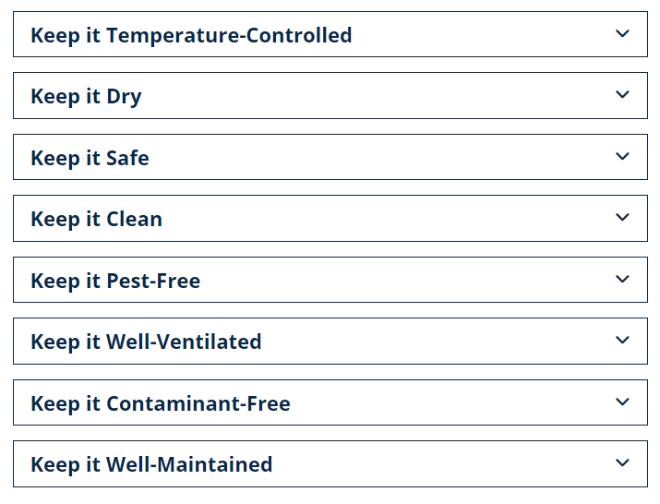
Healthy Homes
UPDATED
Healthy Homes, DOH
Healthy House, Happy Home (PDF)

Slide 11


Hiring an Indoor Air Investigator or Contractor
What type to hire, how to screen, search for an investigator (American Industrial Hygiene Association, AIHA)
What to look for:
  Washington does not require certification for mold inspection or remediation
  Washington Department of Labor and Industries (verify), other organizations (mold)
Image Source: CC BY 2.0 2019 Andrew Fogg, Flickr Creative Commons

Slide 12
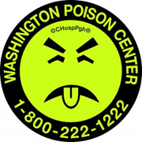
Answers through Phone and Email
Contacts:
  IAQ Email: indoorairquality@doh.wa.gov
  School Env. Health & Safety email: schoolehs@doh.wa.gov
  Mold information line: 360-236-3090
  Ali’s phone: 564-669-0730
What we can do…
  Provide information on common IAQ issues
  Connect to other organizations
What we can’t do…
  Investigate indoor air quality issues
  Answer legal questions
  Field consumer product complaints
Immediate Concerns:
911
Washington Poison Control Center (24-hour toxicologists)
Your health care provider
Image Source: https://www.wapc.org/about-us/about-mr-yuk/

Slide 13
Washington DOH tools to help you navigate concerns with mold cleanup, landlord and tenant mold issues, asbestos, pesticides, and more

Slide 14
Follow Cleaning Best Practices
Keep Carbon Monoxide Out
Disinfect only when necessary
and with safer disinfectants
Remove the Source
Use Safer Art Materials, and Use Them Safely
Avoid Perfumed, Fragranced, and Scented Products
Keep Radon Out

Slide 15
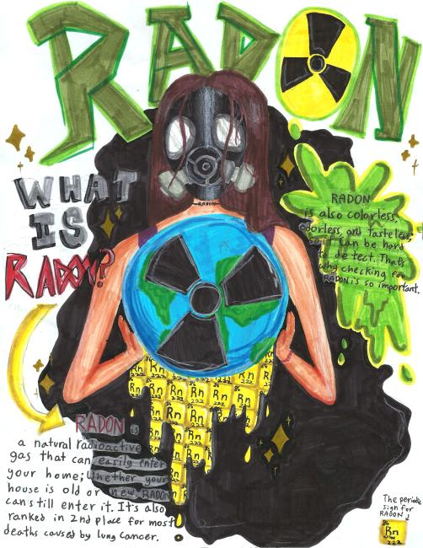
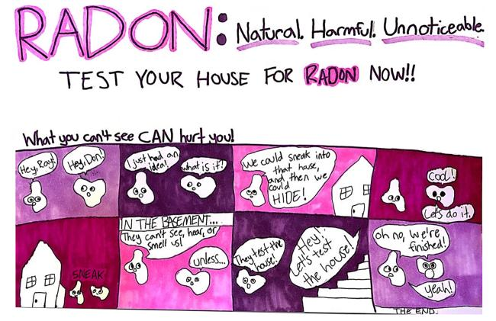
Keep Radon Out
DOH Radon Program website:
Test, fix, re-test
  DIY or professional testing
  Resources for mitigation
DOH Radon in Schools webpage
Northwest Annual Radon Poster Contest
NEW
2024 2nd Place Daphne Sayigh, age 11, Seattle
2024 1st Place Lin Spichiger, age 10, Shelton

Slide 16

Keep Carbon Monoxide Out
Never:
Use unvented gas/charcoal devices inside (incl. RVs/vans, semi-enclosed spaces)
Idle a car in a garage, even when the garage door is open.
Let chimneys, appliance flues become blocked or broken.
Generators:
≥ 20 ft from open windows, doors, intakes
Buy units meeting newer standards (shutoff, emissions)
Install alarms, check batteries regularly (State Building Code Council)
Long-term exposures to low concentrations can be harmful
  8 hrs at 9 ppm is NAAQS, lowest UL alarm 70 ± 5 ppm 60-240 mins (NFPA reviewing)
Image Source: CC BY 2.0 2019 Fred Barr, Flickr Creative Commons
CO and Generator Factsheets | Washington DOH
Consumer Product Safety Commission - Proposed Rule 1281.1
CDC - Carbon Monoxide Poisoning
Ongoing work: HB 1779 23-24 - discussing CO poisonings from sources outside the home
Notes:
Portable generators:
CO emission rates ~100 times greater than gas automobiles¹
Cause ~ 85 deaths and thousands of poisonings every year¹
Peak bodily impact can be hours after the generator is shut off.²
“PGMA G300-2018 has shutoff system requirements but does not have CO emission rate requirements.”
Proposed section 1281.1 provides that, for purposes of this rule, portable generators do not include:
(1) Permanent stationary generators;
(2) 50-hertz generators;
(3) Marine generators;
(4) Generators solely intended to be pulled by, or mounted on vehicles;
(5) Generators permanently mounted in recreational vehicles or motor homes;
(6) Generators powered by compression-ignition engines fueled by diesel;
(7) Industrial-type generators intended solely for connection to a temporary circuit breaker panel at a jobsite.
(Voluntary UL 2201 and PGMA G300; CPSA proposed rule 1281.1 - safety shutoff device and/or CO emission rate limited)
Photo Source: CDC (https://www.cdc.gov/co/faqs.htm).
Image license and disclaimer: https://creativecommons.org/licenses/by/2.0/

Slide 17
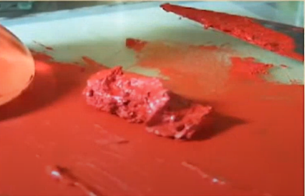
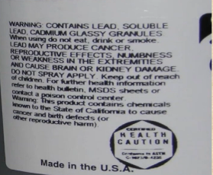
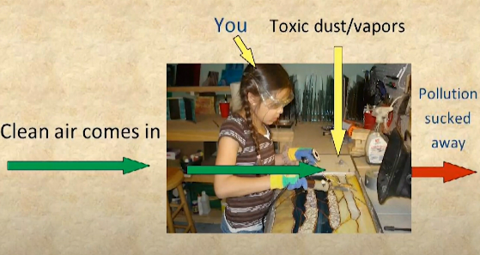
Use Safer Art Materials, and Use Them Safely (Videos)
NEW
Don’t use toxic stuff < use less hazardous stuff < suck stuff away < create a barrier (PPE)
Look at labels:
  Not safe: Danger, Warning, Caution, CL in circle (Caution Label), Health Caution, California Proposition 65
  Safer: Non-Toxic, “AP” in circle
  Label secondary containers with name, main hazard
Watch for:
  Aerosols (for example, powdered ceramics clay)
  Toxic: Metals, Acids, Solvents, Adhesives, Solder
  Other hazards – look at the SDS: Corrosives, flammables and combustibles (low flash point), oxidizers (promote burning)
Ventilate!
Notes:
1988 Labeling of Hazardous Materials Act ---trade secrets – for example, <1 % formaldehyde does not need to be disclosed and can still be harmful)
Toxic Metals (usually color) in fine particles
Toxic Acids: HF in etching, nitric acid and red NO₂ gas
Toxic Solvents: Lacquer thinner > turpentine > mineral spirits > citrus-based (but sensitizer); paint removers, esp. with methylene chloride
Toxic Adhesives – look at the label: hexane + acetone > toluene > hexane > cyclohexane > acetone > heptane > petroleum naphtha > methylpentane > water-based
Lead or cadmium solder, crystallized silica, fluorine-containing flux, cerium buffing
Other hazards – look at the SDS: Corrosives, flammables and combustibles (low flash point), oxidizers (promote burning)

Slide 18


Use Safe Cleaning Practices in Your Home
NEW
Also see: Safely Cleaning and Disinfecting Public Spaces
  Personal Hygiene
    Hand-washing
  How to Clean - Surfaces:
    Often just plain soap and water.
    Microfiber cloth; pad or brush; drain clog tool.
    Clean surfaces that are dirty or touched often.
  How to Disinfect
  Choosing Safer Products
Find social media tools and images: Global Handwashing Day | CDC

Slide 19
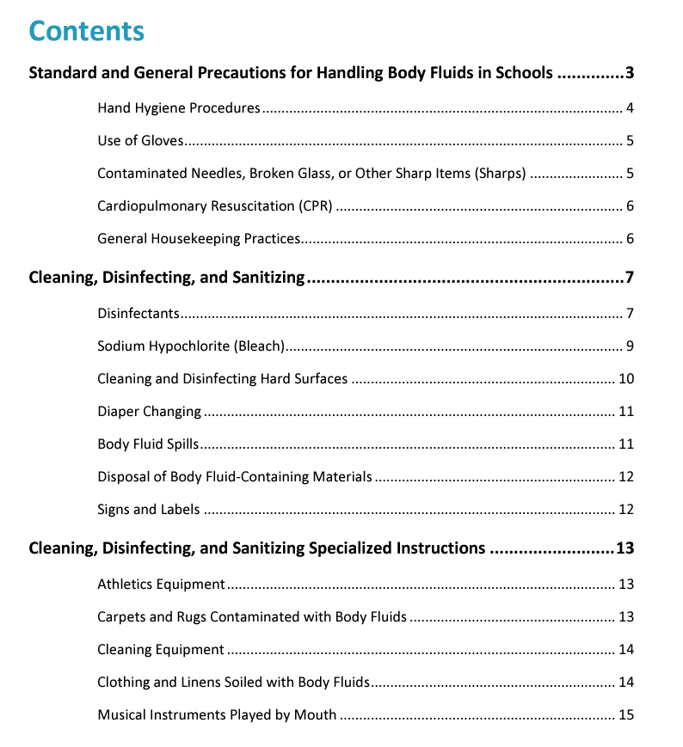
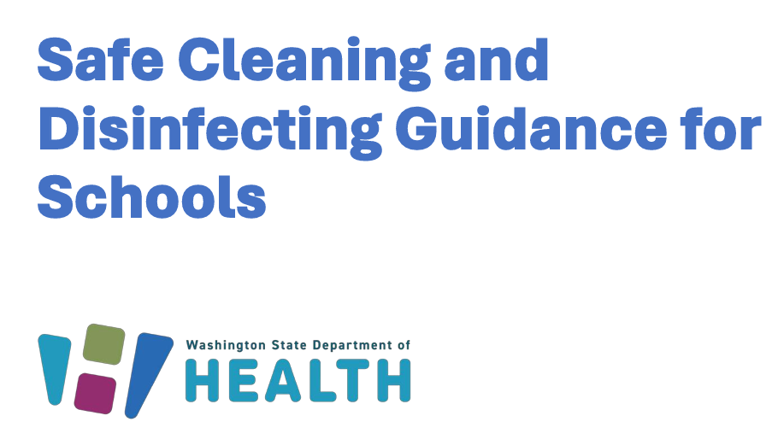
Hand Washing Directions
Use a plain (non-antimicrobial), unscented liquid soap and warm water for routine hand washing.
Scrub hands vigorously for at least 20 seconds. Rinse under a stream of warm water.
Use a paper towel to turn off the water faucet.
Use a fresh paper towel to thoroughly dry hands.
Use a paper towel to open any exit door.

Slide 20


Disinfect only when necessary and with safer disinfectants
“Sanitizing or disinfecting to reduce the spread of disease at home is likely not needed unless there are sick people in your home.” –CDC
If someone is ill or there is vomit or feces to clean up.
Choose safer, fragrance-free products with shorter contact times.
See DOH Safe Cleaning and Disinfecting Guidance for Schools for more specifics.
AVOID Quaternary Ammonium Compounds (“quats”)
Names like …onium chloride
Contribute to antimicrobial resistance
COPD with repeated exposures, reproductive and developmental toxin in animal studies, asthmagen, possible neurological impacts (Seattle Times)
Hydrogen peroxide
NEW
Ethanol
Isopropanol
More info and research:
Safely Clean & Disinfect - TURI - Toxics Use Reduction Institute
Clean Break-Removing Toxics In Cleaning, Sanitizing, and Disinfection Episode 1 - TURI
a
Citric acid
Lactic acid
Search here: DfE-Certified Disinfectants | US EPA
Notes:
Recent review article
For general disinfection, choose a product that is effective against most bacteria and viruses and lists schools as a recommended site. Methicillin-resistant Staphylococcus aureus (MRSA) and influenza viruses are killed by several types of disinfectants.

Slide 21
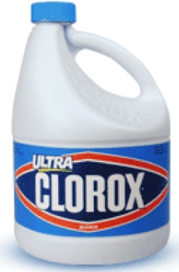
Bleach
Disinfectant. NOT a cleaner.
Hazardous:
  Asthma/respiratory
  Skin and extreme eye
  Corrosive
If use:
  Make a fresh solution daily
  Always use in a well-ventilated area
  Never mix with ammonia, acids, or anything!
  Always wear gloves and eye protection
  Always have an emergency eye wash station
    DOSH Directive 13.0 April 16 2024
Additional information: Safe Cleaning and Disinfecting Guidance for Schools (PDF)
BLEACH
Notes:
Bleach + acid = chlorine gas
Bleach + ammonia = nitrogen trichloride – explosive, extremely irritating
Environmental surfaces that may be contaminated by norovirus should be disinfected using a chlorine bleach solution with a concentration of 1000-5000 ppm (5-25 tablespoons of household bleach [5.25%] per gallon of water)

Slide 22
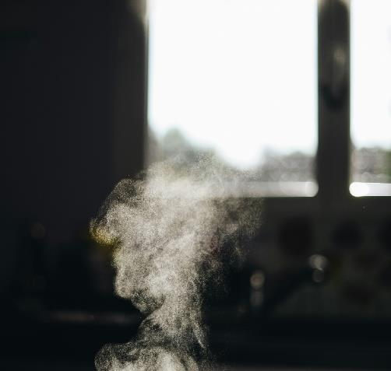
Other Disinfection Options: Superheated Steam
Very effective for cleaning and rapid sanitizing/disinfecting
  Harder-to-kill viruses
  Rapid: under 30 seconds
  Porous surfaces too
Not conventional "steam" cleaners or pressure washers
  Only use a little water and a little electricity to clean, disinfect, and deodorize most surface
  Only head has high temperatures
Photo: Gabrielle Marcel CDC Unsplash
09 08 21 Safer Disinfectant Use Mini Webinar Series: Disinfecting Devices and Best Practices – YouTube (ACMT)

Slide 23
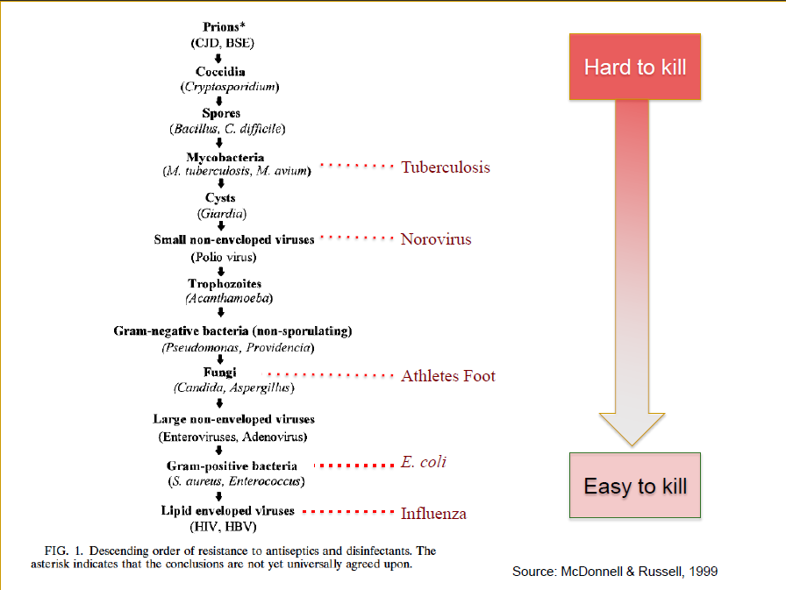
If dealing with nonenveloped viruses such as noroviruses and bacterial spores, a higher level disinfectant is necessary.
For general disinfection, choose a product that is effective against most bacteria and viruses and lists schools as a recommended site.
Notes:
Methicillin-resistant Staphylococcus aureus (MRSA) and influenza viruses are killed by several types of disinfectants.
trophozoite /tropho·zo·ite/ (-zo´īt) the active, motile feeding stage of a sporozoan parasite. (Giardia, amoeba dysentery)

Slide 24
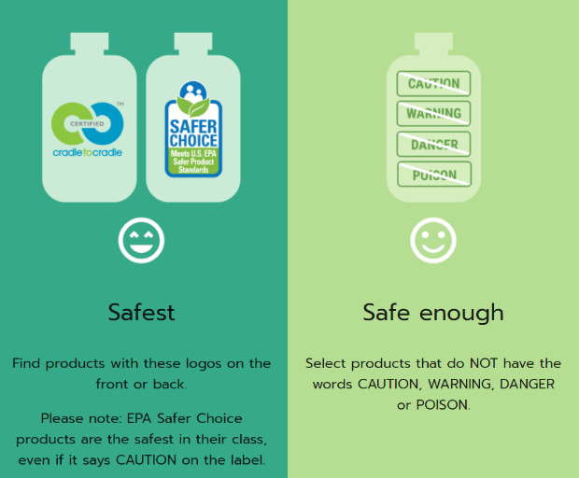
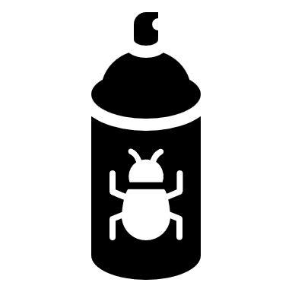
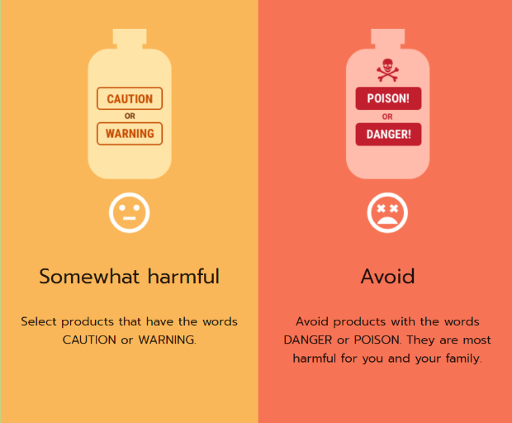
The Label is the Law
Disinfectants are anti-microbial pesticides and must be registered by U.S. EPA and Washington.
Labels contain precautions and/or first aid instructions that must be followed. Basic process:
  Wash with soap
  Rinse
  Use EPA-registered disinfectant
  Ventilate well
If dilution is needed, take appropriate precautions.
Always check the SDS for the formulation and eyewash requirements.
  DOSH Directive 13.0 April 16 2024
  See WSU PICOL database for label
Choose safer, more environmentally-friendly products | Hazardous Waste Management in King County, WA
Notes:
https://www.cpsc.gov/Business--Manufacturing/Business-Education/Business-Guidance/FHSA-Requirements
The Federal Hazardous Substances Act (FHSA) requires precautionary labeling on the immediate container of hazardous household products to help consumers safely store and use those products and to give them information about immediate first aid steps to take if an accident happens.
To require labeling, a product must first be toxic, corrosive, flammable or combustible, an irritant, or a strong sensitizer, or it must generate pressure through decomposition, heat, or other means. Second, the product must have the potential to cause substantial personal injury or substantial illness during or as a result of any customary or reasonably foreseeable handling or use, including reasonably foreseeable ingestion by children.
(3) The signal word “Danger” for products that are corrosive, extremely flammable, or highly toxic;
(4) The signal word “Caution” or “Warning” for all other hazardous products;
(5) An affirmative statement of the principal hazard or hazards that the product presents, for example, “Flammable”, “Harmful if Swallowed”, “Causes Burns”, “Vapor Harmful”, etc.;
(8) The word “Poison” for a product that is highly toxic, in addition to the signal word “Danger”;

Slide 25
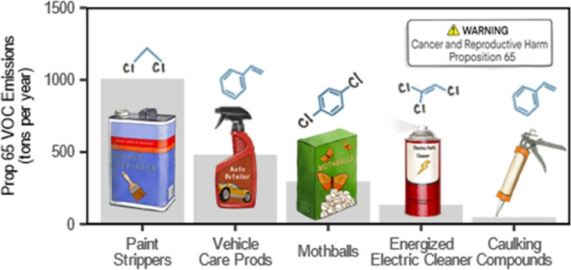
“If it’s on the shelf, it must be safe.”
What’s not usually considered before it’s on the shelf:
  Absence of evidence for harm is not evidence of an absence of harm.
  Regrettable substitution whack-a-mole
Use the precautionary principle
Recent study found 33 known carcinogens, reproductive and/or developmental toxicants in consumer products
  Not considered: neurotoxicity, asthmagenicity, or endocrine disruption.
    Prevalent: Cumene, 1,3-dichloropropene, 1,4-dichlorobenzene, diethanolamine, ethylbenzene, ethylene glycol, ethylene oxide, formaldehyde, methanol, methyl isobutyl ketone, methylene chloride, N,N-dimethyl-p-toluidine, N-methyl-2-pyrrolidone, styrene, tetrachloroethylene, trichloroethylene, toluene
Knox et al., May 2023 doi: 10.1021/acs.est.2c07247
Notes:
TSCA – chemicals considered safe to use in products until clear evidence that causing human harm (high bar)
“Generally regarded as safe” by chemical companies
POPs (persistent organic pollutants)
CA “Prop 65” measures emissions of VOCs, provides data to public by product category
(Safe Drinking Water and Toxic Enforcement Act; regulates for smog-forming potential)
Carcinogens (624), reproductive/development toxicants (323): Proposition 65 – OEHHA
Not considered: neurotoxicity, asthmagenicity, or endocrine disruption
Found that:
33 of the listed chemicals were found in consumer products
Including 16 product categories used on the body
Including 94 product categories used in the workplace – “These categories and chemicals likely cause significant exposures to workers.”
Highest-emitting categories: Paint Removers or Strippers, Automotive Windshield Washer Fluid─colder areas of California (anti-freeze).

Slide 26

Avoid Perfumed, Fragranced, and Scented Products
Volatile chemical products are a primary source of indoor and outdoor air pollutants¹
Asthma attacks, allergies, sensitization, eye, skin, and respiratory irritation
Perfumes, essential oils, air fresheners, diffusers, plug-ins, sprays, deodorizers, shampoos, soaps…
  “Green”, “organic”, “natural”, “un-scented” not regulated
Resources:
  “Essential Oils” - Guidance for Healthy Classrooms (PDF)
  Fragrances in Cosmetics | FDA (who regulates what)
  Fragrances & Work-Related Asthma (ca.gov)
  Fragrance-Free Toolkit from UCLA
  EPA Safer Choice – Fragrance Free products
Image Source: CC BY-NC 2.0 2005 Sam Kim, Flickr Creative Commons
¹ McDonald et al., 2018 10.1126/science.aaq0524
Notes:
REMOVED because Ali needs some time to digest whether this study is sufficient – only four people, not sure what level of exposure, etc.
Persistent exposure to lavender products is associated with premature breast development in girls, according to new research by NIEHS scientists. https://pubmed.ncbi.nlm.nih.gov/31393563/
The findings also reveal that chemicals in lavender oil and tea tree oil are potential endocrine disruptors... https://factor.niehs.nih.gov/2019/9/feature/3-feature-lavender/index.htm?utm_source=efactor-newsletter&utm_medium=email&utm_campaign=efactor-newsletter-2019-September

Slide 27

Fresh air break

Slide 28
Keep it Dry

Slide 29
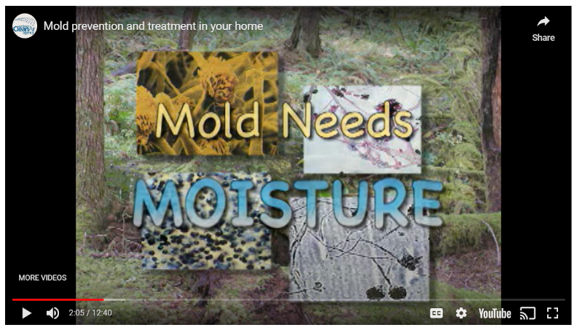
Mold and Moisture www.doh.wa.gov/mold
Video: Mold Prevention and Treatment in Your Home
Mold Information Line: 360-236-3090
E/Mailed information packet:
  Brief Guide to Mold, Moisture, and Your Home (EPA)
  Mold Guidance for Tenants and Landlords brochure (NW Clean Air Agency)
  DOH’s mold webpage
  List of tenant-landlord resources
Update coming very soon!

Slide 30
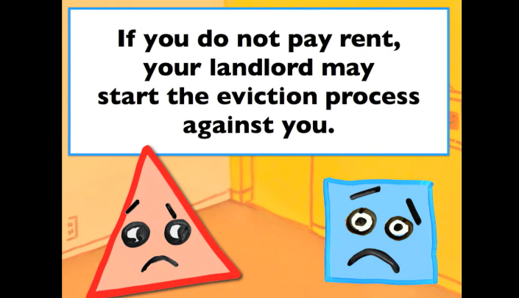
Renters, Landlords, and Mold www.doh.wa.gov/rentermold
Residential Landlord-Tenant Act (self-enforced)
Landlords:
  Fix building problems to avoid moisture buildup
  Notify tenant about health hazards, control
Tenants:
  Operate heating, ventilation to limit condensation
  Communicate to landlord about leaks or moisture
Learn about rights and resources
  Info about requirements and rights
  Resources to handle disputes
Report building code violations to local building code enforcement
  Water/structural – not mold
One example resource we recommend – NW Justice Project / CLEAR line / WashingtonLawHelp.org.
Tenants: If you need repairs | WashingtonLawHelp.org

Slide 31
Mold and Moisture: Key Points
Health concerns (mold and moisture): Asthma, allergies; infections rare
Don’t need to know the color/type
Mold is a moisture problem! Remediation:
  Fix the water problem
  Clean the mold – use soap and water
    Hire a professional if > 10 ft² or commercial or sewage
  Remove water, dry materials promptly (24-48 hrs)
IF clean/investigate, do wear PPE: Mask, goggles, gloves.
Image Source: Avinash Kumar CDC Unsplash

Slide 32
What are the Health Concerns of Mold and Moisture?
Most healthy people don’t react to molds.
  Living/working in a building with mold/damp increases risk
Causal link hard to make.
  Most strongly associated with musty odor, visible mold / dampness
Associated effects:
  Asthma onset/attack, headaches, fatigue, eye/nose/throat irritation, allergies
  Rare: respiratory infections, depression
  Extremely rare (occupational): Inhaled mycotoxin-related diseases, HP, ODTS
Health concerns:
  Immediate: 911 or Washington Poison Center 800-222-1222
  Health professional
Source: AIHA (2020) Recognition, Evaluation, and Control of Indoor Mold, 2nd Ed. American Industrial Hygiene Association, Falls Church, VA.
Notes:
Organic dust toxic syndrome is a potentially severe flu-like syndrome originally described in farmers, mushroom workers, bird breeders and other persons occupationally exposed to dusty conditions. Symptoms arise 4 to 12 hours after exposure to an organic dust, and generally last from one to five days. Common generalised symptoms include fever over 38 °C, chills, myalgia and malaise. The most frequent respiratory symptoms are dyspnea and a dry cough, while a wheeze may be present less commonly. Headache, rhinitis, conjunctivitis and keratitis can also be present, and skin irritation may occur in those handling grain. Respiratory function may worsen to the point where hypoxia occurs, and damage to the airways may lead to non-cardiogenic pulmonary edema one to three days post exposure.[1] The illness is generally self-limiting. Management on the whole is preventive, by limiting exposure to mouldy environments with ventilation, or by wearing respiratory protection such as facemasks.[1]
Source: https://en.wikipedia.org/wiki/Organic_dust_toxic_syndrome
Hypersensitivity pneumonitis (HP) is a syndrome caused by the repetitive inhalation of antigens from the environment in susceptible or sensitized people The inhaled antigens produce a hypersensitivity immune reaction causing inflammation of the airspaces (alveoli) and small airways (bronchioles) within the lung.[4] In the acute form of HP dose of antigen exposure tends to be very high but only for a short duration. Symptoms include fever, chills, malaise, cough, chest tightness, dyspnea, rash, swelling and headache. Symptoms resolve within 12 hours to several days upon cessation of exposure.[1] Source: https://en.wikipedia.org/wiki/Hypersensitivity_pneumonitis

Slide 33
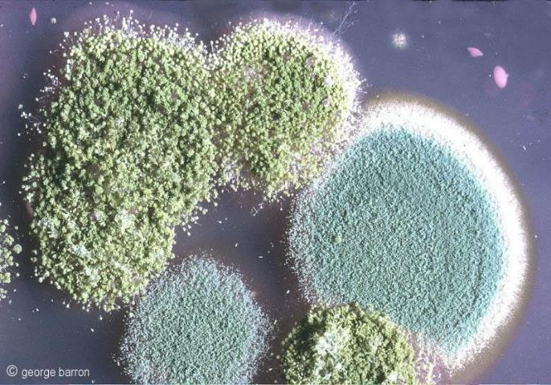
Are Molds “Toxic”?
Mycotoxins
  Only cause harm by inhalation at extreme concentrations
    In agriculture/heavy exposure be wary
  Research ongoing
What about “Black mold”? Color doesn’t matter.
  All indoor molds are potential health hazards and need to be cleaned up.
Aspergillus flavus and Penicillium cyclopium.
Source: George Barron - Fungi Image Collection.
More info:
Mycotoxins | WHO
Mold, Testing, and Remediation | NIOSH | CDC
Notes:
Nancy
Resources:
https://www.fda.gov/food/natural-toxins-food/mycotoxins

Slide 34
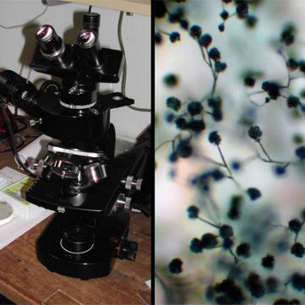
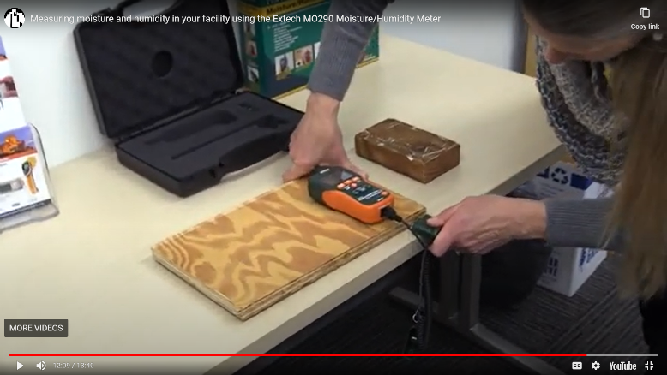
Should I recommend sampling?
No. Sampling is not usually needed.
  Insurance or legal purposes.
It’s not useful.
  No standards for “unhealthy” levels
  It’s everywhere!
  Type doesn’t (usually) matter
Instead:
  See, smell (musty/moldy, dirty socks)
  Moisture meter (pins/against wall), RH meter
Types of sampling: Surface (tape), air, blood (definitely a no), skin allergen
` If wanted, done by a professional.
Image Source: Mold Image Library | US EPA
Read more: A Brief Guide to Mold, Moisture and Your Home | US EPA
Additional slide with literature in extra slides
    Video: Moisture/RH Meter (Building Potential)

Slide 35
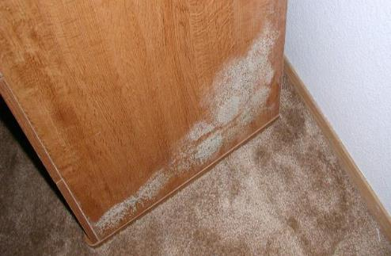
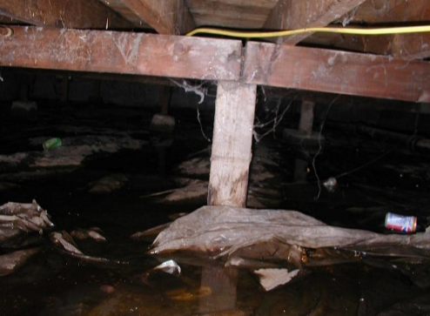
Common mold causes
Roof, window, and plumbing leaks
Condensation onto cool surfaces
Occurs when air saturated with water contacts a cool surface, like a soda can in the summer.
Poor external drainage
  Mold Guidance for Tenants and Landlords brochure (NW Clean Air Agency)

Slide 36
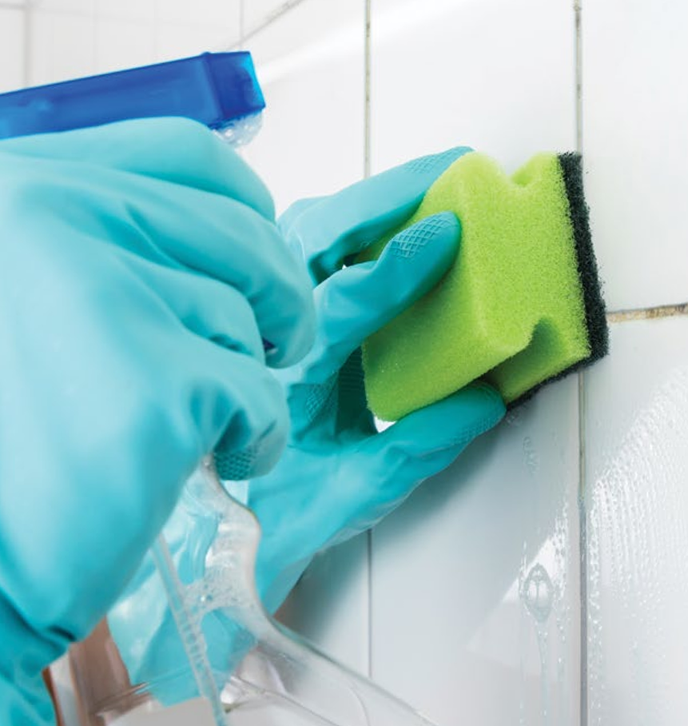
Cleanup: Basics
Scrub mold with soap or detergent solution.
Disinfectants unproven, seldom needed (i.e., sewage).
  Need to remove the mold.
  If use, must be registered (WSDA, EPA); ventilate!
  Gases, aerosols, foggers NOT recommended.
Use a vacuum with a HEPA filter; limit dust generation.
Dry all materials and remove all visible mold.
NYC: What Tenants Should Know about Indoor Allergens (Local Law 55 of 2018) – NY state and NYC have mold rules
Notes:
An antimicrobial pesticide is intended to disinfect, sanitize, reduce, or mitigate growth or development of microbiological organisms or protect inanimate objects, industrial processes or systems, surfaces, water, or other chemical substances from contamination, fouling, or deterioration caused by bacteria, viruses, fungi, protozoa, algae, or slime.
Source: https://www.epa.gov/pesticide-registration/antimicrobial-pesticide-registration
To report a suspected pesticide misuse or drift: https://agr.wa.gov/departments/pesticides-and-fertilizers/pesticides/compliance

Slide 37

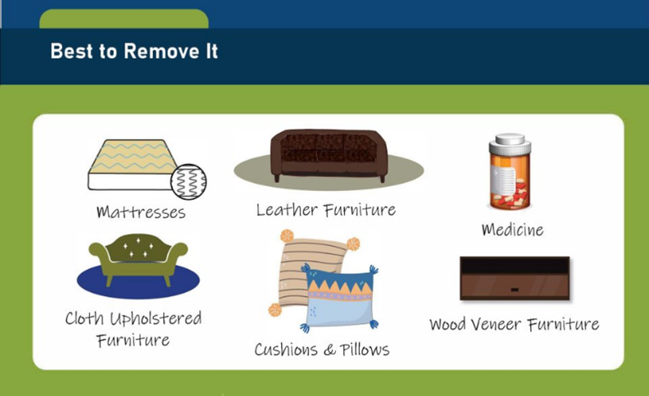


What Can I Keep?
More info: Mold Remediation in Schools and Commercial Buildings Guide: Chapter 4 | US EPA
epa.gov/flooded-homes

Slide 38
Ventilate Well

Slide 39
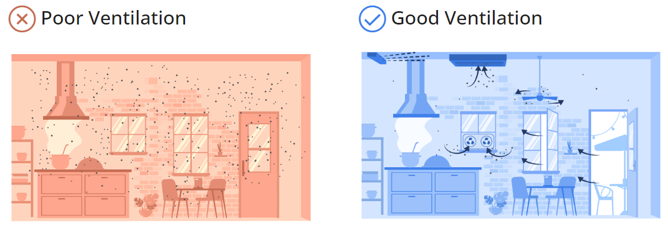
Ventilate with Fresh Air and Upgrade Filters
Aim for at least 5 air changes each hour outside air. CO₂: bring in more fresh air above 800 ppm.
Upgrade to MERV-13 filters. (It’s in the mechanical code in Washington now!)
Keep your system operating as designed
  Inspect and maintain local exhaust ventilation in restrooms, kitchens, cooking areas, and labs.
  Change filters seasonally, inspect monthly
Without HVAC, open windows and doors to create a cross draft, use fans to increase effectiveness.
DOH does not recommend additive technologies, including UV in most spaces.
Ventilation and Air Quality for Reducing Transmission of Airborne Illnesses (PDF)
Improving Ventilation and Indoor Air Quality During Wildfire Smoke Events (PDF)
CDC guidance (spring 2024)
Ventilation While Cooking
NEW
Notes:
51-52 605.4 Particulate matter removal. Particulate matter filters or air cleaners shall have a minimum efficiency reporting value (MERV) of not less than the following:
1. MERV 13 for ducted air handlers and ventilation systems serving occupiable spaces in Groups A, B, E, M, R and I occupancies.
2. MERV 8 for ducted air handlers and ventilation systems serving occupiable spaces in Groups F, H, S, and U occupancies.
3. MERV 4 for unducted air handlers and fan coil units.
EXCEPTIONS:
1. Ducted air handlers and ventilation systems 500 cfm or less shall have a filter not less than MERV 8.
2. Recirculated air at fan powered variable air volume terminal units with hydronic heating coils or electric resistance heating elements shall have a filter not less than MERV 8.
3. Exhaust or relief air upstream of a heat exchanger or coil shall have a filter not less than MERV 6.

Slide 40
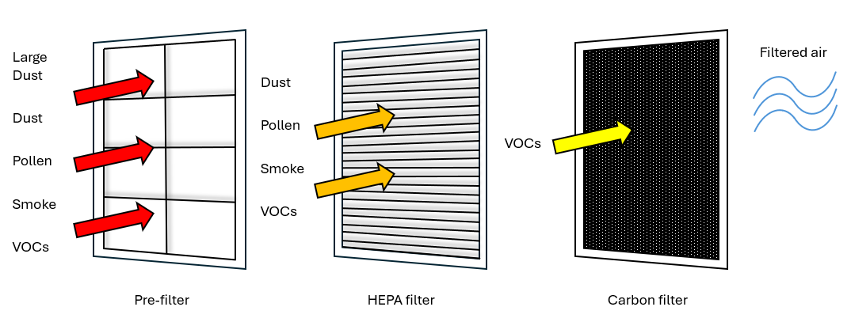
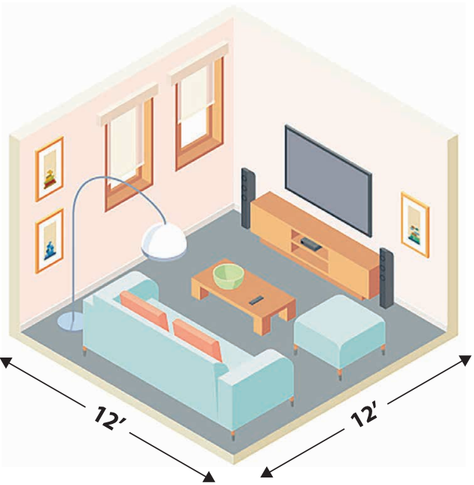
Choose Portable Air Cleaners Thoughtfully
Important way to remove wildfire smoke, airborne illnesses, dust, and pollen from indoor air.
Look for these four basic criteria:
Filter only – no ionic, ozone, or UV technologies
A real HEPA filter
The right size for your room (CADR)
Not too loud
Detailed guide about choosing a portable air cleaner.
Good guidance: NIH - Selection and use of Portable Air Cleaners
In progress

Slide 41
Keep Outdoor Pollution Out

Slide 42
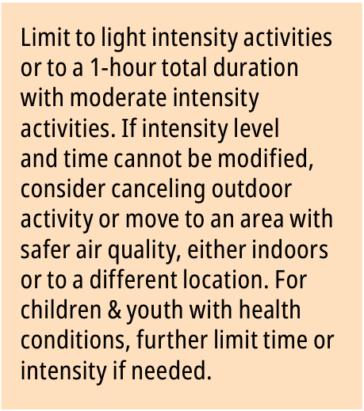
Smoke From Fires Webpage
Primary annual PM_{2.5} NAAQS update (EPA)
Activities guide
  In Partner Toolkit
  Appendices include info on using sensors, decision scenarios
Improving Ventilation and IAQ During Wildfire Smoke Events: Recs for Schools and Buildings with Mechanical Ventilation
Notes:
What this guide provides – example guidance
Recommendations such as this most contentious category of unhealthy for sensitive groups include:
Limiting the intensity level of the activity
Limiting the duration of the activity
Moving the activity indoors or to somewhere with better AQ
Canceling the activity altogether
Special considerations for kids with health conditions

Slide 43
IAQ Inspections and Investigations in Schools
Should IAQ measurements be part of a routine inspection?
  Temperature, relative humidity, air movement (fogger), airflow and CO₂ (EPA Reference Guide for IAQ in Schools)
    Note the conditions. For CO₂, lots of people? May want to do longer msmt.
  Don’t recommend other chemicals – difficult to interpret, expensive, challenging. Examples: Total VOCs, specific VOCs like formaldehyde
    Try other approaches first (removing/reducing sources, increasing ventilation), then hire a professional
    PM_{2.5}: This can be useful if measured over longer periods of time and compared to outdoors. Read more: Children & Youth Activities Guide for AQ
Resources: School Walk-Through Videos, School Environmental Health and Safety Workshop
  Health Department School Inspections, TPCHD (PDF), Indoor Air Quality Continuous Monitoring, PSWCT-UP (PDF), Indoor Air Quality Monitoring (PDF), Post Pandemic Ventilation Guidance (PDF)
Schools | Washington State Department of Health
Notes:
(1) All rooms used by students or staff shall be kept reasonably free of all objectionable odor, excessive heat or condensation.
(2) All sources producing air contaminants of public health importance shall be controlled by the provision and maintenance of local mechanical exhaust ventilation systems as approved by the health officer.

Slide 44
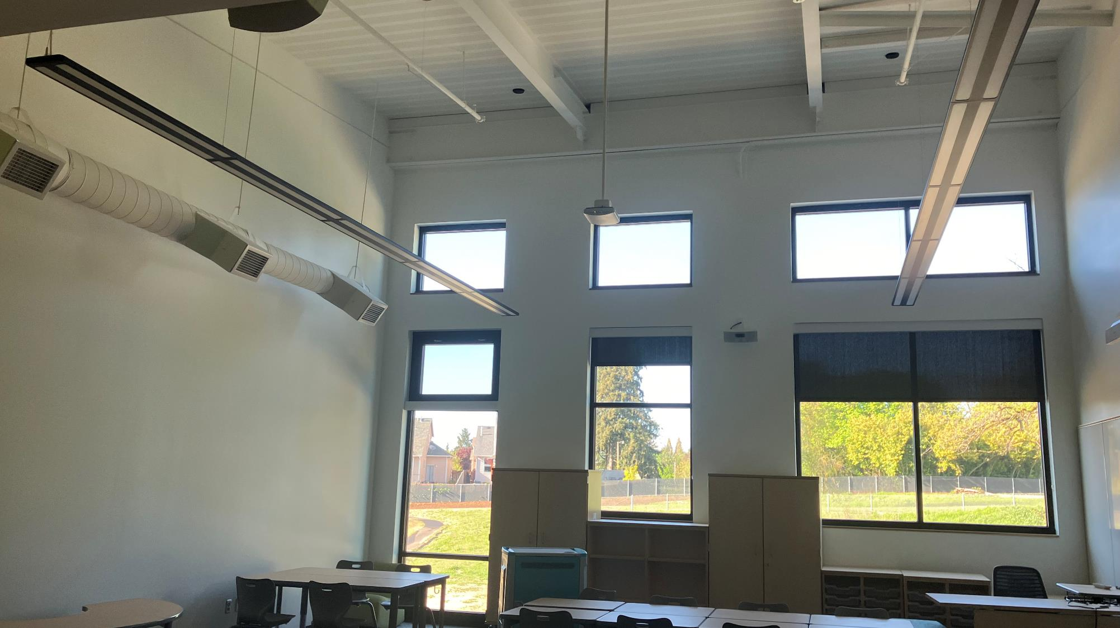


Questions & Discussion
Thank You
Ali Boris, PhD
Ali.Boris@doh.wa.gov
564-669-0730
Indoor Air Quality Specialist
School EH&S + IAQ Program
Environmental Public Health
Washington DOH
www.doh.wa.gov/iaq
www.doh.wa.gov/schoolenvironment

Slide 45
Accessibility notice

Slide 46
Extra Slides
Indoor Environment – other contaminants

Slide 47

Be Aware of Fentanyl and Analogs
NEW
Fentanyl Exposure in Public Places | Washington DOH
Risk of overdose is extremely unlikely from exposure to the smoke from someone who is smoking fentanyl.
If you see drug paraphernalia such as pipes, liquid, or powder, leave the area immediately and contact law enforcement or the facility manager.
Being around any kind of smoke is unhealthy. Open windows and doors to get rid of the smoke.
If you see powder or a crushed pill on a nearby surface, do not touch it or attempt to remove it. Do not open windows or do anything that might cause powder to get into the air.
Clandestine lab cleanup different – U.S. EPA: Fact Sheet: Fentanyl and Fentanyl Analogs, Voluntary Guidelines for Methamphetamine and Fentanyl Laboratory Cleanup
Lethal dose of fentanyl (U.S. EPA)
Notes:
2mg lethal dose * (1g/1000mg) * (1 mL/1.087g) * (1 tsp/4.929 mL) = 0.000373 tsp

Slide 48
How to Notify: Pesticides Registration and Misuse Claims
Recommended source for pesticide health hazards: National Pesticide Information Center
Pesticides, including disinfectants, must be registered (WSDA 15.58 RCW and U.S. EPA FIFRA) prior to use.
  EPA uses company-provided data that comply with testing guidelines to determine potential risk to humans and environment.
  About Pesticide Registration | US EPA
    Acute, chronic, reproductive, and developmental toxicity to mammals, birds, and fish, the pesticide's environmental fate, degradation, translocations, and ecological studies on its harmful effects to nontarget plants and animals.
  WSDA has an additional registration program and enforces FIFRA in Washington
    Exception: tribal land (EPA)
    WSU PICOL database with OR/WA registered products
Chapter 15.58 RCW is the Washington Pesticide Control Act. It includes requirements for registration and proper use of pesticides. The Washington State Department of Agriculture (WSDA) is responsible for enforcing this act.
To notify the WSDA about a drift or misuse of a pesticide:
PCompliance@agr.wa.gov
1-844-388-2020
Washington Department of Labor and Industries may also be contacted by WSDA for incidents involving employees.
Notes:
Marie Hallinen, US EPA region 10: “EPA is responsible for registering all pesticides for use nationally (every legal product will have an EPA registration number on it); states have their own registration programs that may be more stringent or restrictive than EPA (but states can’t authorize the use of a pesticide that’s not federally registered). States also have “primacy,” meaning that they have primary authority when carrying out FIFRA enforcement. For Washington state, the agency in charge is WSDA. Although EPA may have responsibility in certain cases – for example, enforcement on tribal land, or when a state requests assistance.
U.S. EPA registration: The data EPA requires for product registration includes studies on acute, chronic, reproductive, and developmental toxicity to mammals, birds, and fish, the pesticide's environmental fate, degradation, translocations, and ecological studies on its harmful effects to nontarget plants and animals.
But yes, you’re correct, this data is provided by the registrant, who submits studies that comply with EPA testing guidelines. You can read more about the registration process here: https://www.epa.gov/pesticide-registration/about-pesticide-registration#registration
There’s also a certification for disinfectant products EPA has, the “design for the environment” label, that distinguishes products that meet a more stringent criteria: https://www.epa.gov/pesticide-labels/learn-about-design-environment-dfe-certification
I also like to refer folks to the National Pesticide Information Center when questions of product safety or risk come up: http://npic.orst.edu/

Slide 49
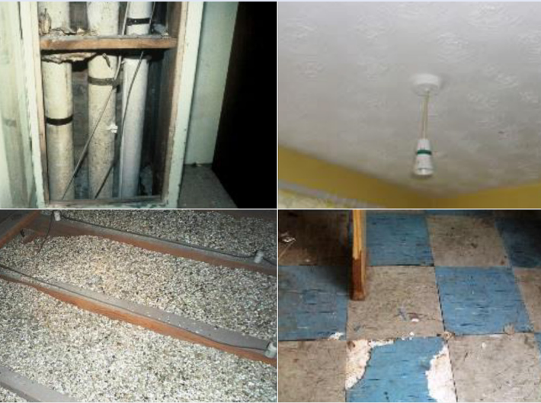
Asbestos
Health Risks
Asbestos Containing Material
  Whether to test (can’t know unless you test)
  If in doubt, treat as if it contains asbestos
  EPA’s Proposed Ban of Ongoing Uses of Asbestos
Repair, removal, disposal
  L&I
  Clean Air Agencies/tribal governments/Ecology
Preventing exposure
Schools
  Asbestos Hazard Emergency Response Act (AHERA)
Naturally occurring
Sources of asbestos
Source: CDC ATSDR – Asbestos in Your Environment
Notes:
Nancy
L&I: Federal and state laws govern asbestos removal and disposal. For more information, including directions for building owners, construction contractors, and asbestos abatement contractors see Labor and Industries' asbestos removal requirements.
Ecology/CAAs: If you are the homeowner and the home is not used for commercial purposes you can clean it up yourself. You must follow federal and state laws. The Department of Ecology administers the Asbestos National Emissions Standards for Hazardous Air Pollutants (NESHAP) and requires notification before demolishing or renovating facilities with asbestos containing materials. In areas of the state with a local Clean Air Agency, the responsibility is delegated to them.
Before beginning any demolition or remodel project, you must check for asbestos and follow the specific guidelines for properly identifying, handling, removing, and disposing of any asbestos that might be disturbed. For regulations and guidance, contact your local Clean Air Agency or Ecology Regional Office.
AHERA (1986) required public and non-profit schools to inspect, identify, and remediate
Asbestos Ban and Phaseout Rule (Remanded )
On July 12, 1989, the EPA issued a final rule banning most asbestos-containing products. In 1991, this regulation was overturned by the Fifth Circuit Court of Appeals. However, as a result of the Court's decision, only a few asbestos-containing products remain banned.

Slide 50
Extra Slides
Ventilation and filtration

Slide 51

More Recommendations
Dilute and filter out particles and gases:
Wildfire smoke
Infectious aerosol particles
Pollen, mold spores
Volatile organic chemicals (activated carbon)
Improve filtration
Deepest pleat possible – less resistance
Filter the return and incoming air
Tight fit – NO LEAKS
Change seasonally/as needed
Supplement with portable HEPA air filters
Ventilate
Direct Air Movement
  Positive pressure, direct exhaust
  Maximize outside air
  Set for maximum occupancy
  Open windows and doors
Do not add anything to the air!
Source: Elisa Sparkman, Thurston County Public Health Healthy Homes program

Slide 52
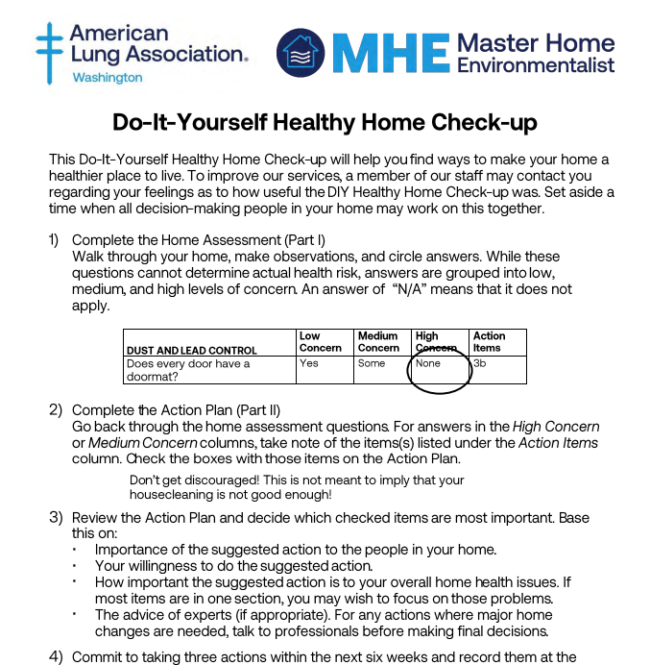
Resources linked on our IAQ website
Ventilation and Air Quality for Reducing Transmission of Airborne Illnesses (PDF)
    HVAC, homes with no HVAC, portable air cleaners
Improving Ventilation and Indoor Air Quality During Wildfire Smoke Events (PDF)
Cooling Indoor Spaces Without Air Conditioning (PDF)
    Also in Spanish
Do-It-Yourself Home Health Assessment
  Checklist-style tool for determining how to improve IAQ in your home
  Multiple languages

Slide 53
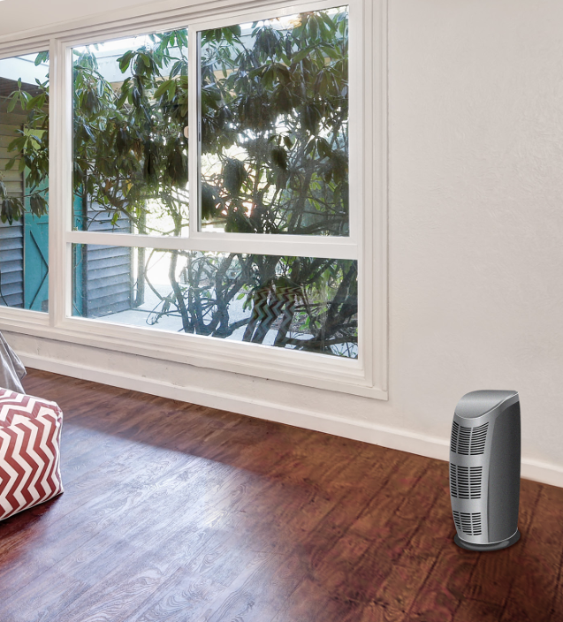
Particle Filtration Recommendations
Filtration Terminology
CADR: Clean Air Delivery Rate. A filter metric considering the single-pass efficiency and airflow rate.
HEPA: High Efficiency Particulate Air (filter). Must remove ≥99.97% (ASME, U.S. DOE) of particles with diameter of 0.3 µm.
ACH: Air Changes per Hour. How many times the air in the room fully moves through the HEPA unit in an hour (aim for 5 or more).
MERV: Minimum Efficiency Reporting Value. Rating for filters depending on efficiency in filtering particles of specific sizes (table).
Filtering within Building Ventilation System
Minimum of MERV 13 for Recirculated Air
  Protect against indoor contaminants such as COVID-19
  Placed in air handling unit after return air duct enters
Minimum of MERV 13 for Outside Air
  Protect against outdoor contaminants such as smoke
  Can be placed at any location in air handling unit, but typically after a coarser filter
  Option to add charcoal filter for VOCs (requires more frequent replacement)
Image source:
EPA - Air Cleaners and Air Filters in the Home

Slide 54
Air Ventilation Energy Efficiency Technologies
One feedback to consider: Using more energy to ventilate by running fossil fuel power plants creates more air pollution
  Some of these technologies can also remove humidity, combustion exhaust, improving IAQ
Sources:
  HVAC Retrofit | Department of Energy
  Smart Ventilation for Advanced California Homes | Lawrence Berkeley Lab
  Dedicated outdoor air system - Wikipedia
Air Economizer: Uses measurements to automate amount of outdoor air used rather than re-circulated, cooled/heated air
  Can have installation, maintenance issues that waste energy; most effective in mild climates (LBL)
  Question: do these every consider outdoor/indoor air quality such as PM?
Building Automation System (BAS): Use computer system to operate HVAC (based on timing, sensors, user inputs)
  Can make quick adjustments during incidents and events
Demand Control Ventilation (DCV): Use a proxy for occupancy (CO₂, RH, IR, microwave, sound) in building automation
  Minimizes energy use and can improve IAQ compared to no ventilation
  Doesn’t work well if low occupancy, can be difficult to get settings right, may not ventilate immediately
Dedicated/Dual Outdoor Air Systems (DOAS): An HVAC system with separate conditioning equipment for outdoor, return air
  Reduces ventilation air required (still have recirculated air), often paired with energy recovery ventilation
  May be more expensive at first, complex
Energy Recovery Ventilation (ERV): Use temperature and humidity of outgoing, cooled/heated air to condition incoming air
  Heat Recovery Ventilation (HRV) only transfers temperature
  Blower required to make up for pressure drop, so some energy use

Slide 55
Air Ventilation Energy Efficiency Technologies
Examples:
River Trails Middle School in Mt. Prospect, Illinois, implemented an upgrade of the HVAC controls and retro-commissioned the building systems. The project resulted in a 27 percent annual energy savings and an $18,900 annual cost savings. Project size: 109k ft²; $207k.
Mt. Washington Elementary School in Kentucky was selected by the Bullitt County Public School District to undergo a major renovation of the HVAC system, lighting, and indoor air quality (replaced HVAC and geothermal, improved lighting). The 1.5-year project resulted in an annual energy savings of 32 percent and annual cost savings of $28,000. Project size: 65k ft²; $4.5 million.
Vista Peak Preparatory in Aurora, CO, was selected by the Aurora Public School District to undergo a 14-month recalibration of the HVAC system to maximize energy savings potential. The project is estimated to realize a 20 % energy use intensity reduction and an annual energy cost savings of $54,000. Project size: 218k ft²; $20k.
Source: Smart Ventilation for Advanced California Homes | Lawrence Berkeley Lab
Resources:
  NREL Advanced Energy Retrofit Guide provides practical ways to improve energy efficiency, from existing building commissioning to whole-building retrofit.
  New Buildings Institute Zero Net Energy School Retrofit Trainings are recorded events (webinars and workshops) on how existing K-12 school and community college buildings in California achieved zero net energy performance.
  EPA Energy Savings Plus Health: Indoor Air Quality Guidelines for School Building Upgrades recommends ways to manage energy-efficiency upgrades and indoor air quality in schools.

Slide 56
UV-C Germicidal Technologies
Current recommendation: 254 nm technology may be useful IF large, high-occupant space with high ventilation rate and installation/maintenance is professionally done
High energy light (254 nm or 222 nm) can inactivate viruses and bacteria, but raises some health concerns:
  254 nm light produces secondary VOCs and PM (•OH by photolyzing O₃ from outdoor air), can damage eyes and skin
  222 nm light produces secondary VOCs and PM (O₃ by photolyzing O2), less likely to damage eyes and skin but used without guard
To prevent build-up of harmful secondary products, EPA and CDC has discussed using high ventilation rates.
  Note that gases are not removed without charcoal filters
Recommended reading:
  Unwanted Indoor Air Quality Effects from Using Ultraviolet C Lamps for Disinfection | Environmental Science & Technology Letters (254 nm)
  Indoor Air Quality Implications of Germicidal 222 nm Light | Earth, Space, and Environmental Chemistry | ChemRxiv | Cambridge Open Engage (222 nm)
  Model Evaluation of Secondary Chemistry due to Disinfection of Indoor Air with Germicidal Ultraviolet Lamps | Environmental Science & Technology Letters (both)

Slide 57
Monitoring CO₂ for ventilation improvements: Schools
Lower grade (ages 6-10)
Upper grade (ages 11-16)
Average CO₂ emission: 0.0043 L/s-person
About 10.5 L/s-person outside air needed to keep CO₂ below 800 ppm
Average CO₂ emission: 0.0057 L/s-person
About 14 L/s-person outside air needed to keep CO₂ below 800 ppm
Currently, International Building Code required outdoor air ventilation rate is about 7 L/s-person. What’s really necessary is debated, but students’ cognitive ability and even health can be impacted by high concentrations of CO₂.
Note that there are a lot of assumptions in this calculation
Source: U.S. Department of Energy – Office of Energy Efficiency & Renewable Energy

Slide 58
Extra Slides
heat

Slide 59
Indoor Environmental Quality – Temperature in Schools
Students do not learn well at elevated temperatures
  Hot classrooms may cause ≤ 13 % of the black and Hispanic achievement gap (1)
  Significantly lower testing scores observed with days > 80 °F (2)
  Washington schools observe indoor temperatures ≤ 96 °F (3)
Children are less able to regulate body temperature than adults (American Academy of Pediatrics)
Minimum temperature (WAC 246-366-090) must be 65 °F (entire facility with students, employees during school hours) and 60 °F in gym
No maximum temperature, but “excessive heat” is prohibited in all rooms used by students or staff (WAC 246-366-080)
  Some school districts may have rules or guidance
Exercise caution and common sense during an excessive heat event
Use ASHRAE 55 to determine thermal comfort (“normal indoor clothing”)
  At RH = 60 %: Winter: 68-74.5 ºF, Summer: 74.5-79 ºF
  At RH = 40 %: Winter: 69-75.5 ºF, Summer: 74.5-81 ºF
  The Washington Sustainable Schools Protocol requires compliance
Additional Resources:
ASHRAE Center for the Built Environment (CBE) Thermal Comfort Tool
Cooling indoor spaces without air conditioning (wa.gov)
Child Care Weather Watch (c-uphd.org)
Protecting-Californians-with-Heat-Resilient-Schools.pdf (ucla.edu)
Harvard Kenney School 2018 working paper
Park et., 2020 doi: 10.1038/s41562-020-00959-9
NEA article: Without Air Conditioning, Students and Staff Suffer

Slide 60
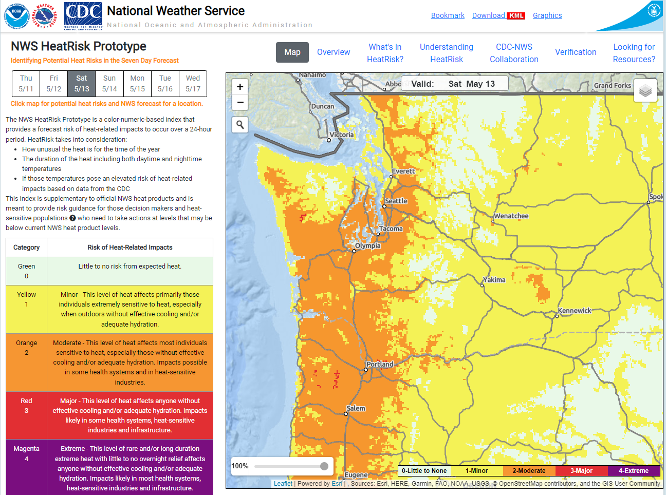
Indoor Environmental Quality – Temperature
https://www.wrh.noaa.gov/wrh/heatrisk/
Heat Risk
Useful metric that’s currently used by western US NWS
Considers climate/location (normalized), event length, overnight low, daytime high, time of year
Uses AQI colors

Slide 61

Indoor Environmental Quality - Temperature
High heat is the most dangerous weather in Washington
  100 people died in one week in the 2021 heat wave
  Can cause dehydration, exhaustion, injury, and death
Watch the forecast and plan
  Keep activities to early morning or after sun goes down
  If outdoors, have water and access to shade
  Watch current wildfire risk and burn bans, be safe with fires
Dress for the weather
  Loose, breathable clothing, wide-brim hats
  Sunscreen with high UV protection
Drink lots of (non-alcoholic) fluids
  Sweat drains moisture. Keep water near during activities, in your car
Keep your home cool
  Close windows and blinds in the morning, use fans to move cool air inside, open windows after the sun goes down
Head to a cooling center
  Go if you are not able to keep your home cool
  Provide AC, shade, and water
See the DOH Extreme Heat website for more info

Slide 62
Extra Slides
childcares

Slide 63
Child Cares
Child care cleaning requirements:
  “Disinfect” definition in WAC 110-300-0005
  Sanitizer and disinfectant requirements mentioned in WAC 110-300-0240
  DCYF encourages used of fragrance-free products:
    WAC 110-301-0240: “(c) If a bleach solution is used for sanitizing or disinfecting, a school-age provider or their designee must use one that is fragrance-free and follow the DOH's current guidelines for mixing bleach solutions for child care and similar environments.”
    “Oils and scents that are diffused throughout the air are not approved for use during child care hours. Despite being considered natural, the composition of scents and oils can induce reactions for individuals who may already have compromised or sensitive respiratory or immune systems. Essential oils can cause respiratory ailments, endocrine disruptions, and rashes if they come into contact with skin and are therefore prohibited. Please contact your local licensing office if you have further questions on this topic.”
  The food code only requires cleaning of lunch tables.
DOH guidance (updated last year):
  Disinfecting and Sanitizing with Bleach Guidelines for Mixing Bleach Solutions for Child Care and Similar Environments
  Cleaning, Sanitizing, and Disinfecting for Child Cares
The child care codes default to bleach for sanitizing/disinfecting, but DCYF will approve safer products, including hydrogen peroxide-based ones.
  Where sanitizing/disinfection is required, surfaces have to be cleaned with soap and water first before the sanitizer/disinfectant is used.
  Bleach is not a cleaner and should never be used for cleaning. It is also ineffective if the soap is not removed first.
  The use of many of these products is not safe for children.
You could encourage your child care to follow the Eco-Healthy Child Care® (EHCC) - Children's Environmental Health Network (cehn.org) recommendations.

Slide 64
Extra Slides
Mold and moisture

Slide 65
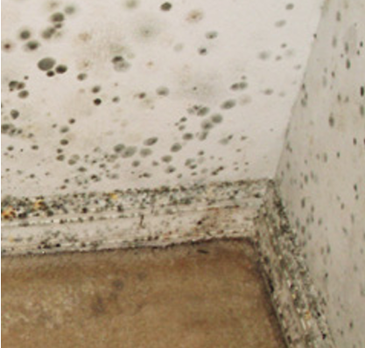
Scientific Consensus: If you sense it, remove it.
California Department of Health – Dampness, Mold, and Health
“… sound, science-based Permissible Exposure Limits (PELs) for indoor molds could not be established … To date [in 2016], no federal or state policies set safe exposure limits or quantify the health risks from dampness and mold in buildings.”
“There also is consensus that the traditional measurement methods used to identify increased mold exposure do not reliably predict increased health risks.”
“current consensus does not justify the differentiation of some molds as toxic molds that are especially hazardous to healthy individuals.”
AIHA (2020) Recognition, Evaluation, and Control of Indoor Mold, 2nd Ed. American Industrial Hygiene Association, Falls Church, VA.
“…no specific ideal assessment protocol using these indicators has yet been agreed upon, nor has a standardized threshold been determined that would be universally considered to indicate maximum acceptable levels of indoor [mold and dampness].”
“Evidence-based public health advice currently recommends remediating any indoor [mold/dampness] that can be seen or smelled, without specification of a threshold.”
More References:
Kanchongkittiphon W, Mendell MJ, Gaffin JM, Wang G, Phipatanakul W. Indoor environmental exposures and asthma exacerbation: an update to the 2000 review by the Institute of Medicine. Environmental Health Perspectives 2015;123:6-20; www.ncbi.nlm.nih.gov/pmc/articles/PMC4286274/
Mendell MJ, Mirer AG, Cheung K, Tong M, Douwes J. Respiratory and allergic health effects of dampness, mold, and dampness-related agents: a review of the epidemiologic evidence. Environmental Health Perspectives, 2011; http://ehp.niehs.nih.gov/1002410/
World Health Organization. WHO Guidelines for Indoor Air Quality: Dampness and Mould. Copenhagen: WHO Europe, 2009 (Chapter 4, Health effects associated with dampness and mould); www.euro.who.int/__data/assets/pdf_file/0017/43325/E92645.pdf
Krieger J, Jacobs DE, Ashley PJ, et al. Housing interventions and control of asthma-related indoor biologic agents: A review of the evidence. Journal of Public Health Management and Practice, 2010, 16(5):S11–S20; www.ncbi.nlm.nih.gov/pmc/articles/PMC3934496/
U.S. Environmental Protection Agency. Mold. Washington, D.C.: USEPA; www.epa.gov/mold

Slide 66

Remediation Work: What to Look for
Steps – Assessment, Planning
Steps - Remediation
Assess the size, extent
Create a remediation plan
  Specific procedures
  Fix, cleanup, PPE, containment, disposal
  Temporary relocation or hours of remediation
Follow remediation plan
Fix water/RH problem
Communicate
Completely dry, clean mold
  Appropriate methods
Recommend separate company
Suggested: follow-up inspection by separate company (Ex: NYS rules)
Image Source: Avinash Kumar CDC Unsplash

Slide 67
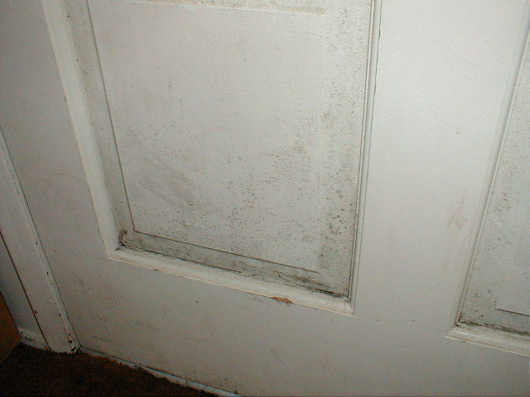
Cleanup: Surfaces
Hard surfaces – mild detergent and a scrub brush
  Dry thoroughly (dehumidifiers/fans/heaters)
  Biocides/chemical disinfectants not necessary
  Take items outside – sunlight
  Do Not Paint/Caulk Over Mold
Porous/absorbent materials – discard (in plastic)
  See Restoration specialist for valuables
Wood – dry completely
Carpet/pad – not usually salvageable
Fabrics – hot water wash/see tag
See Table 1: Water Damage – Cleanup and Mold Prevention in the Mold Remediation in Schools and Commercial Buildings Guide| US EPA (Page 11)
Image Source: Northwest Clean Air Agency – Mold Guide for Tenants and Landlords

Slide 68
Common mold cause: Roof, window, and plumbing leaks
Where to look: Building envelope
  Flashing/penetrations, roof
  Windows/doors
  Water table - crawlspace
Fix:
  Repair leaks, clean up
Prevention:
  Regular inspection and maintenance
Image Source: Northwest Clean Air Agency – Mold Guide for Tenants and Landlords
Notes:
Top: Leak from roof or plumbing: Left unrepaired, a small leak can become a big problem. This wallboard must be removed using personal protection and a plastic enclosure under negative pressure exhausted to outside to prevent further contamination of occupant property. The ceiling and wall cavities will also be moldy and need careful cleaning by protected workers.
Bottom: Plumbing leak: Prompt communication with a landlord could have prevented this damage.

Slide 69
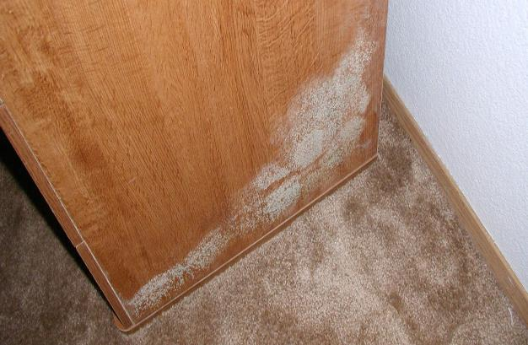
Common mold cause: Condensation onto cool surfaces
Occurs when air saturated with water contacts a cool surface, like a soda can in the summer.
What to look for:
  High air RH
    Tight buildings, lack of fresh air
    Breathing/plants
  Temperature differentials
    Coverings on windows
    Furniture against exterior walls
Image Source: Northwest Clean Air Agency – Mold Guide for Tenants and Landlords
Notes:
Top: Condensation: Mold growing on roof "sheathing" in an attic. In winter months, moisture (water vapor) leaking through the ceiling of the living area with the force of warm air rising will condense on the cold attic sheathing, causing property damage and mold exposure to occupants. Left uncorrected, the roof will fail and need replacement.
Bottom: Mold growth caused by condensation on the cool cabinet placed against an exterior wall in a rental unit. The excessive indoor relative humidity (regularly exceeding 60%) was the culprit. This surface can be cleaned with soapy water.

Slide 70
Common mold cause: Condensation onto cool surfaces
Fix: Keep air moving, dry, and temp-controlled.
Ventilation with outdoor air
  A/C or clean dehumidifiers
  Windows, distribute with cross-breeze
  Aim for 30 – 50 RH%
Use local exhaust fans
  Vent to outside
  Keep clean, working
  45 minutes after shower
  Vent basements/crawlspaces
Winter: Heat the air (warmer air “holds” more moisture)
Image Source: Northwest Clean Air Agency – Mold Guide for Tenants and Landlords
Notes:
Condensation: Tenants kept the apartment at 60 degrees, cold enough that the back side of their dresser was below “dew point”, the temperature at which typical moisture levels in the air will condense on a surface. With the dresser chronically wet, mold got started and amplified. This can probably be scrubbed off (outside!) and painted. To prevent a recurrance of the mold, surfaces need to be kept warmer either by increasing the apartment temperature and/or allowing air circulation behind the dresser, or lowering the relative humidity in this space.

Slide 71
Common mold cause: Condensation onto cool surfaces
Fix: Keep surfaces dry.
Space between furniture, exterior walls
Dry off as needed:
  Windows
  Cold water pipes
  Insulation
  Uninsulated wall/ceiling interfaces, corners
No vinyl wallpaper on exterior walls
Image Source: Northwest Clean Air Agency – Mold Guide for Tenants and Landlords
Notes:
Top: Too much moisture in the air (high relative humidity) leads to unwanted condensation on cool surfaces like double pane windows in cold weather. The moisture drips down, accumulates on sills, and can leak into wall cavities below causing hidden mold growth on wood and paper backed wallboard. Single pane windows will be colder still, resulting in condensation even with normal indoor humidity levels (below 40%) and may require daily drying of sills with towels to prevent mold growth and water damage.
Bottom: Condensation from excessive indoor moisture on the window glass drained and ponded on the window sill, soaked into and wicked up the drywall, and provided plenty of moisture to cause the mold growth visible next to the window.

Slide 72

Common mold cause:
Poor external drainage
What to look for:
  Drainage toward building
  High water table
Fix/prevention:
  Gutters 5’ from building
  Slope ground away from foundation
  Keep crawlspace dry: proper lining (contractor)
  Use drains
Image Source: Northwest Clean Air Agency – Mold Guide for Tenants and Landlords

Slide 73
Mold resources for additional questions:
Mold guidance for tenants and landlords | Northwest Clean Air Agency (great pictures and info! I suggest reading through this one.)
Mold Course: Introduction | US EPA
Mold Image Library | US EPA
Hiring an Indoor Air Investigator or Contractor | Washington DOH – also see the slide on this.
There’s no WA certification for mold inspection, remediation. Look for:
Experience cleaning up mold
Good references
Willingness to follow EPA/AIHA recommendations
Verify on WA L&I website
Consider other organizations’ accreditations:
  IICRC Mold Remediation Specialist certification: for professionals; tests for competencies in: remediation, containment, safety, mold growth conducive conditions and prevention, documentation. This is an ANSI certified standard (national). While we don’t own the standard, we do recommend looking for this certification in mold professionals, and they do include recent health-based research on cleanup practices such as not using ozone generators (here’s a snippet of their standard used for draft changes).

Slide 74
Extra Slides
Cleaning and disinfecting

Slide 75
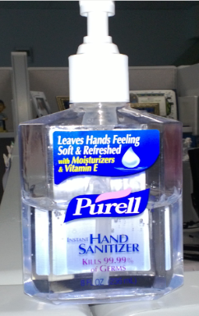
Hand Sanitizer
Not a substitute for hand washing
Not effective on dirty hands
At least 60% alcohol (isopropyl or ethyl)
Hands should stay wet for 20+ seconds
Not considered effective on non-enveloped viruses or spores
Flammable / poison
Fragrance free
Be careful of dangerous products (methanol, 1-propanol)
  https://www.fda.gov/drugs/drug-safety-and-availability/fda-updates-hand-sanitizers-consumers-should-not-use
Not recommended:
  Benzalkonium chloride, “quat” based / non-alcohol / “natural”
  CDC: Show Me the Science:
  http://www.cdc.gov/handwashing/show-me-the-science-hand-sanitizer.html
Notes:
Examples of unproven claims found on product labels are
kills over 99.9% of MRSA
helps prevent skin infections caused by MRSA and other germs
is effective against a broad spectrum of pathogens, including MRSA
One company claims that its hand sanitizing lotion prevents infection from the bacterium E. coli and the H1N1 flu virus. And another firm claims its “patented formulation of essential plant oils” kills the bacterium Salmonella. These claims are also unproven and, therefore, illegal.
“FDA has not approved any products claiming to prevent infection from MRSA, E. coli, Salmonella, or H1N1 flu, which a consumer can just walk into a store and buy” says Autor. “These products give consumers a false sense of protection.”
http://www.fda.gov/ForConsumers/ConsumerUpdates/ucm251816.htm

Slide 76

Choose Safer Disinfectants
EPA’s
Design for the Environment
Safer Antimicrobial Pesticide Project
The DfE logo on an EPA-authorized antimicrobial pesticide label means that the product:
  Is in the least-hazardous classes (III & IV) of EPA’s acute toxicity)
  Is unlikely to have carcinogenic or endocrine disruptor properties
  Is unlikely to cause developmental, reproductive, mutagenic, or neurotoxicity issues
  All ingredients reviewed
  Does not require the use of agency mandated PPE
  Has no unresolved efficacy failures
  Has no unresolved compliance/enforcement actions

Slide 77
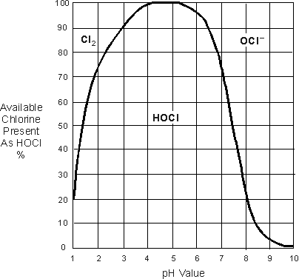
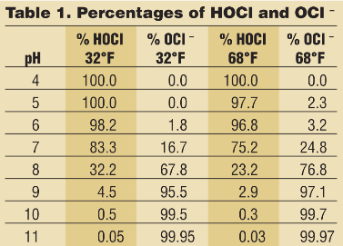
Other Options
Hypochlorous Acid (HOCl)
  Dominant active ingredient when operated in pH range of 4-6
    Other ranges will have mixture of chemicals
TURI testing looking at potential Cl₂ exposure during usage
09 08 21 Safer Disinfectant Use Mini Webinar Series: Disinfecting Devices and Best Practices - YouTube
https://www.wcponline.com/wp-content/uploads/2009/06/28-30-1.png

Slide 78
Air Disinfection: Upper Room Ultraviolet Germicidal Irradiation (UVGI)
Safety Considerations
Direct exposure to the UVGI lamp can harm eyes and skin
Need to work with a reputable manufacturer and building engineer to install
Need to follow recommended maintenance and bulb replacement schedule (maintenance needs to shut off light before accessing system)
UVGI bulbs contain mercury- need to follow EPA guidance for safe handling and disposal if broken
UV dose should be monitored regularly

Slide 79

Say NO….
Cake toilet deodorizers
  paradicholorobenzene
Citrus & Terpene Solvents
  D-Limonene
  Mopping can create air pollution that rivals city streets | Science | AAAS
  “One molecule of concern is limonene, which is commonly added to cleaners and furniture polish to help remove oil and grease. The lemon-scented molecule reacts readily with ozone, an outdoor pollutant that is the main ingredient in smog. When ozone wafts into buildings, it reacts with limonene and similar molecules called monoterpenes, turning them into peroxides, alcohols, and other molecules that grow into airborne particles. Small particles can lodge deep in the lungs, irritating cells and—at high enough exposure—leading to health problems, such as asthma. In vulnerable people, particulate air pollution can cause heart attacks and strokes.”
Nano Technology
  nano-silver
“Air Fresheners”
Ozone generators
Fragrances
Anti-microbial soaps
  Triclosan / Triclocarban
  Quaternary Ammonia compounds

Slide 80

Make Time for Handwashing!
At School:
When coming inside from playing
After going to the bathroom
Before preparing food
Before eating
After touching animals
Remove oils/dirt/feces
Remove lead/pesticides
IF you absolutely do not have access to soap and water – scrub with an unscented baby wipe and then use an alcohol-based hand sanitizer.
Sinks in art area of a newly constructed (2023) Washington elementary school

Slide 81


Do not Aerosolize Chemicals
Into the Air
Example: Disinfectant sprayers and foggers
Stay in air for long time, especially if not well ventilated¹
Can irritate skin, eyes, airways^{1,2}
  People with asthma more vulnerable¹
WHO does not recommend²
Liquid disinfectants are sufficient¹
  Spraying into air – no wet time
  Scrub with soap and water first^{1,2}
  Guidance for COVID-19 but evaluates risks (CDC, EPA, WHO)
Spraying individuals with disinfectants is not recommended under any circumstances²
Image Source: CC BY-NC 2.0 2005 Alliance for Excellent Education, Flickr Creative Commons
Sources:
¹ CDC - Safety Precautions When Using Electrostatic Sprayers, Foggers, Misters, or vaporizers for Surface Disinfection During the COVID-19 Pandemic
² WHO - Situation Report 115 - Subject in Focus: Cleaning and Disinfection of Environmental Surfaces
³ EPA’s List N: Disinfectants for Coronavirus
Image Source: CDC (1)

Slide 82


